Slide 1
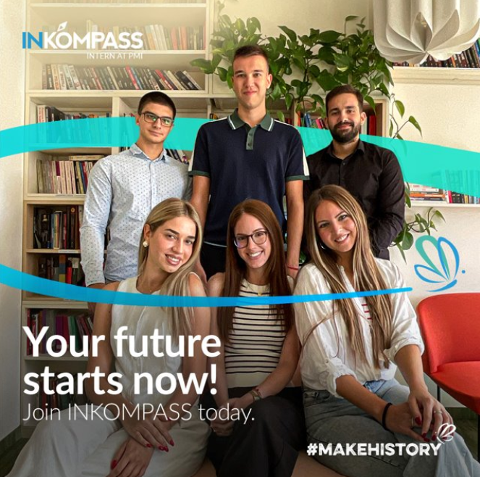
INKOMPASS 2027
BY PHILIP MORRIS INTERNATIONAL
A 12-MONTH PAID INTERNSHIP IN NIŠ
ABOUT INKOMPASS
Become part of a modern manufacturing environment where you can learn alongside experienced colleagues, contribute your ideas and develop practical skills. Explore how different teams work together, connect your academic knowledge with everyday business and discover where your strengths can make an impact.
REAL
PROJECTS
MENTORSHIP
HANDS-ON
EXPERIENCE
START YOUR JOURNEY
STARTS 1 FEBRUARY 2027
Notes:
[Sources]
Internal source: INKOMPASS_2027_Nis_Job_Ad_Draft.docx.
Design reference and photography: user-provided INKOMPASS visual.
[/Sources]

Slide 2
E X P L O R E T H E O P P O R T U N I T I E S
Find the area that fits your interests
Nine teams across our Nis manufacturing operations
COULD THIS BE YOU?
PRODUCTION
OPEN+
QUALITY
Daily manufacturing operations
Continuous improvement
Quality systems & improvement
Final-year Bachelor’s students
Master’s students
ENGINEERING
IT
EHS
Technology & process improvement
Systems, data & digital solutions
Safety, risk & environment
Recent graduates
SUPPLY PLANNING
FACTORY LOGISTICS
SECURITY & MARKET SAFETY
Good command of English
Planning, data & coordination
Material flow & optimization
Risk prevention & business protection
Curious, proactive and ready to learn
Explore the teams and find where you could make an impact
Notes:
[Sources]
Internal source: INKOMPASS_2027_Nis_Job_Ad_Draft.docx.
Design reference: user-provided INKOMPASS visual.
[/Sources]

Slide 3
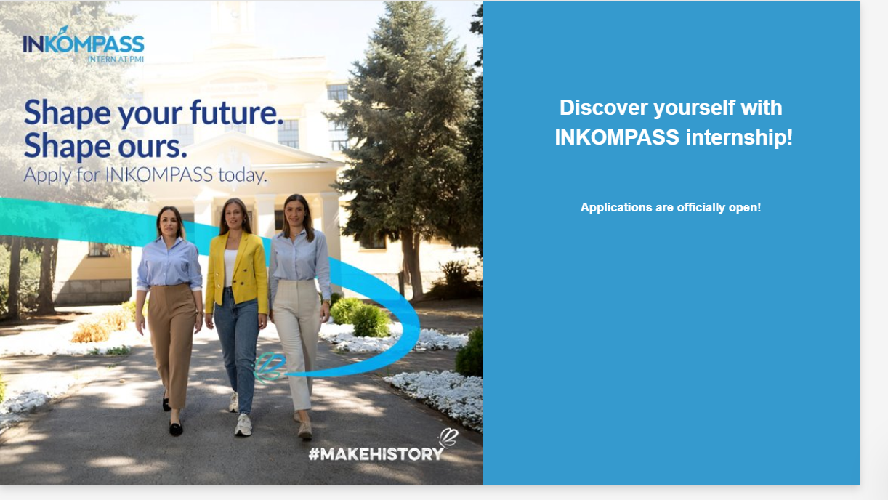
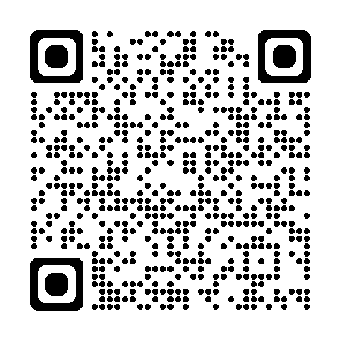
Notes:
[Sources]
User-provided INKOMPASS application visual with QR code.
[/Sources]

